Slide 1
General Update
SPR
AC replacement INITIATED
Other
Antenna control box retrofit
2x RFSoC board delivered
2x RFSoC boards next week
Weather station failed, replacement ordered
REU field trip to HCRO (Sarah will take over organization)
27 of June to 3 of July
Agenda in prep.
Berkeley House:
Quotes for: roof, asbestos removal, windows, electric wiring, new kitchen
CHIME:
Agreement draft send to Chime
Need to get quotes for geotechnical survey
Construction permit minor modification
List of available equipment at HCRO
Design work:
Weather station data connection and power supply
Antonio Feed
Trip to Minex this weekend
2H feed 002 installed and tested
Diaphragm pumps not available currently
3C showed failure on Monday
2B needed azimuth motor replaced DONE
4G needs elevation drive replaced
Sunbrella measurement
With and Without
Dry and Wet
Feed focus measurement
Mobile setup needed
Feed focus need to be tested at all antennas

Slide 2
Antonio Feed Overview
18 Antennas fully operational
14 / 19 Antonio Feeds

Slide 3
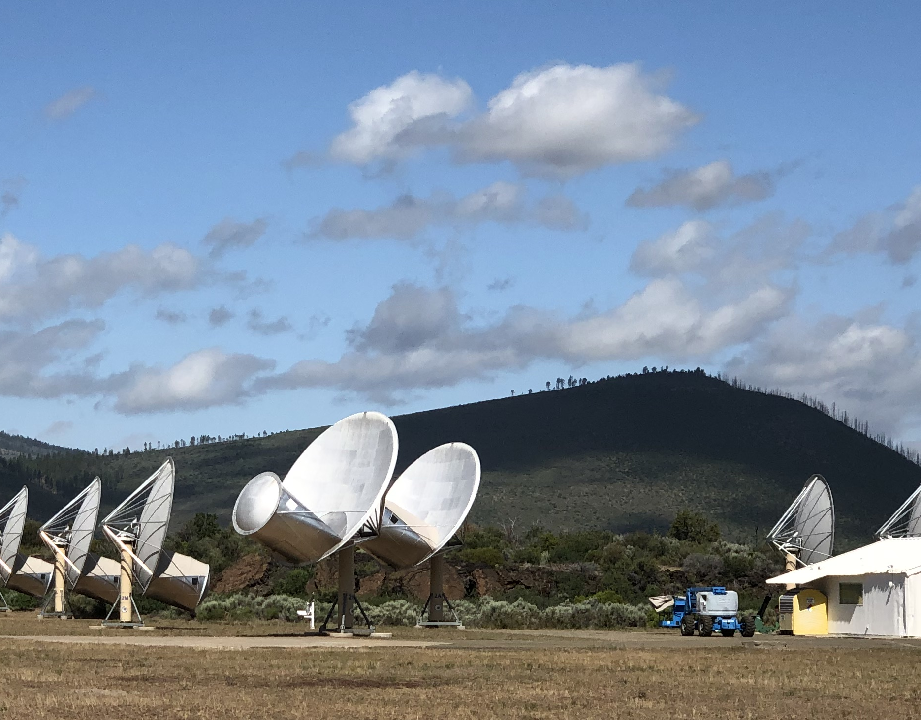
Sunbrella measurements:
SEFD with and without dry sunbrella

Slide 4
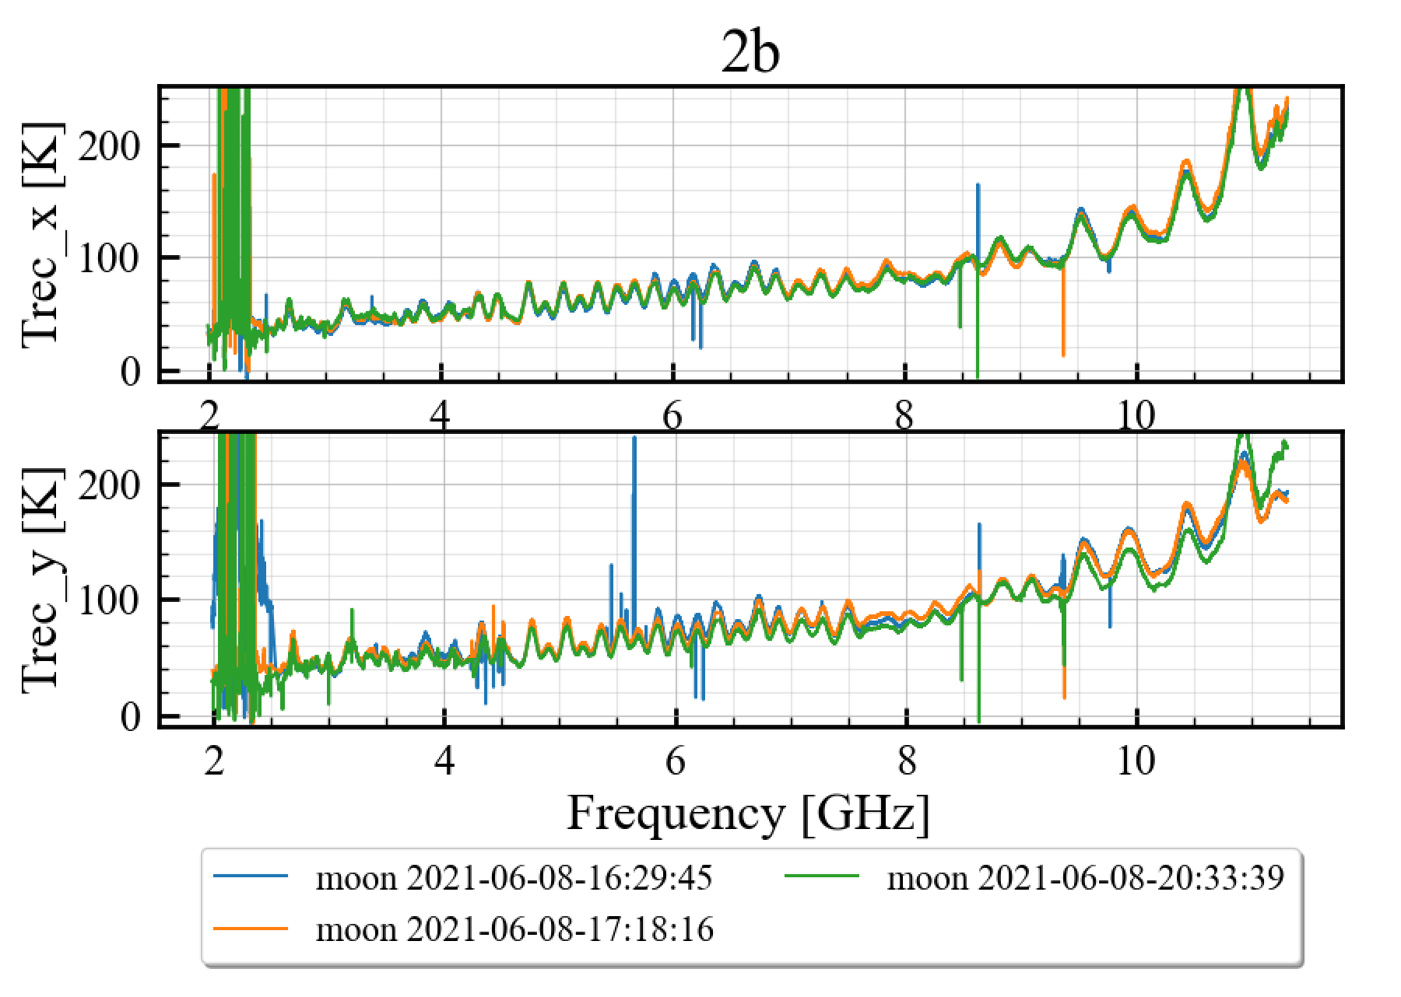
Sunbrella measurements:
SEFD with and without dry sunbrella
Blue + Orange => without sunbrella
Green => with sunbrella

Slide 5
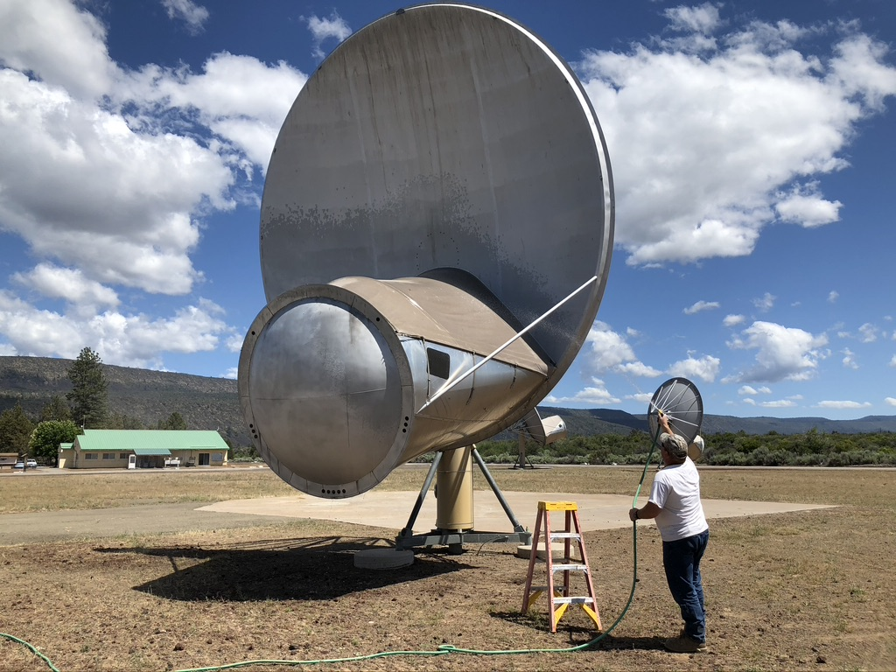
Sunbrella measurements:
SEFD with wet sunbrella

Slide 6
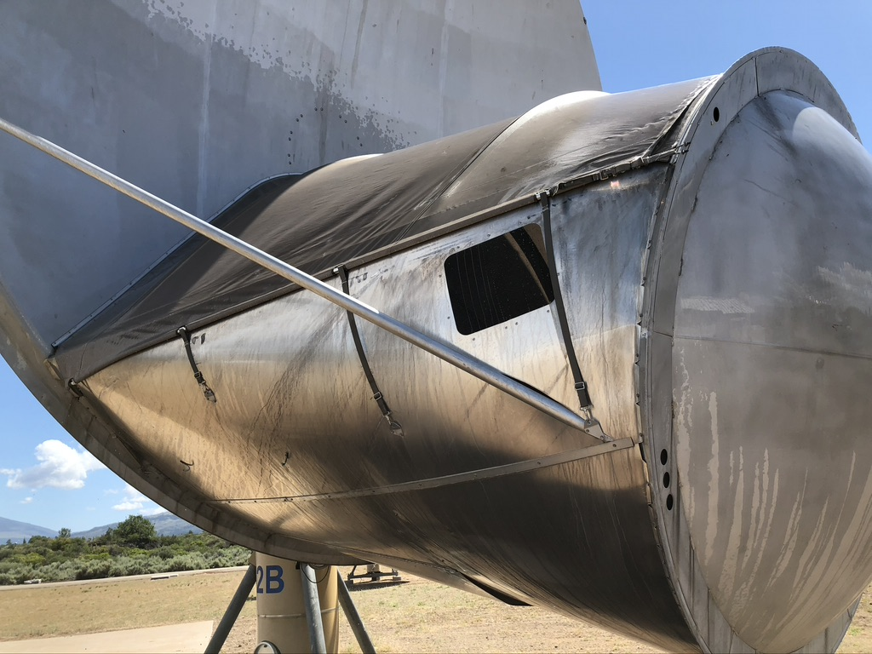
Sunbrella measurements:
SEFD with wet sunbrella

Slide 7
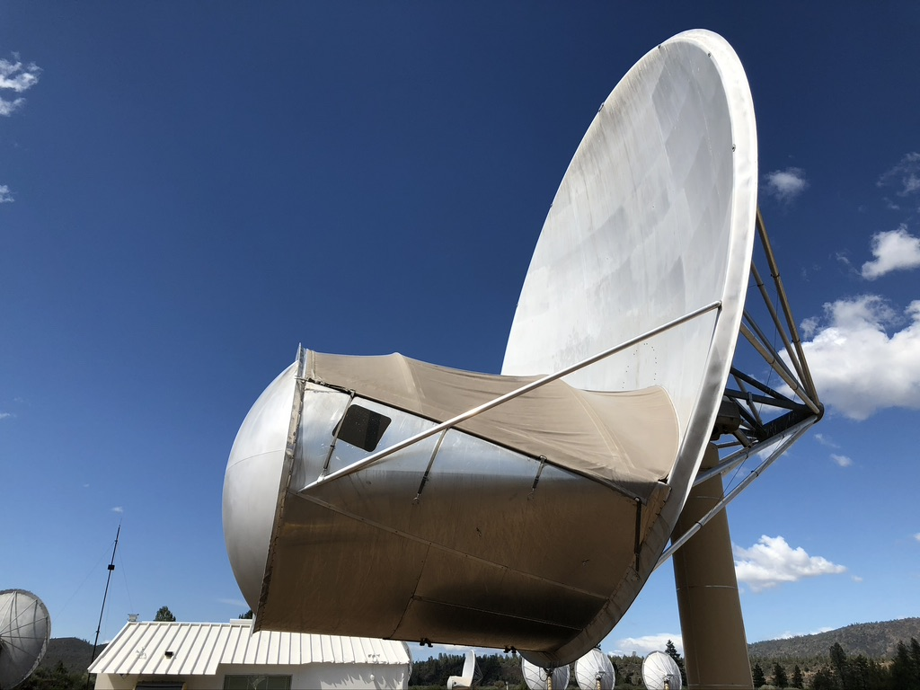
Sunbrella measurements:
SEFD with wet sunbrella

Slide 8
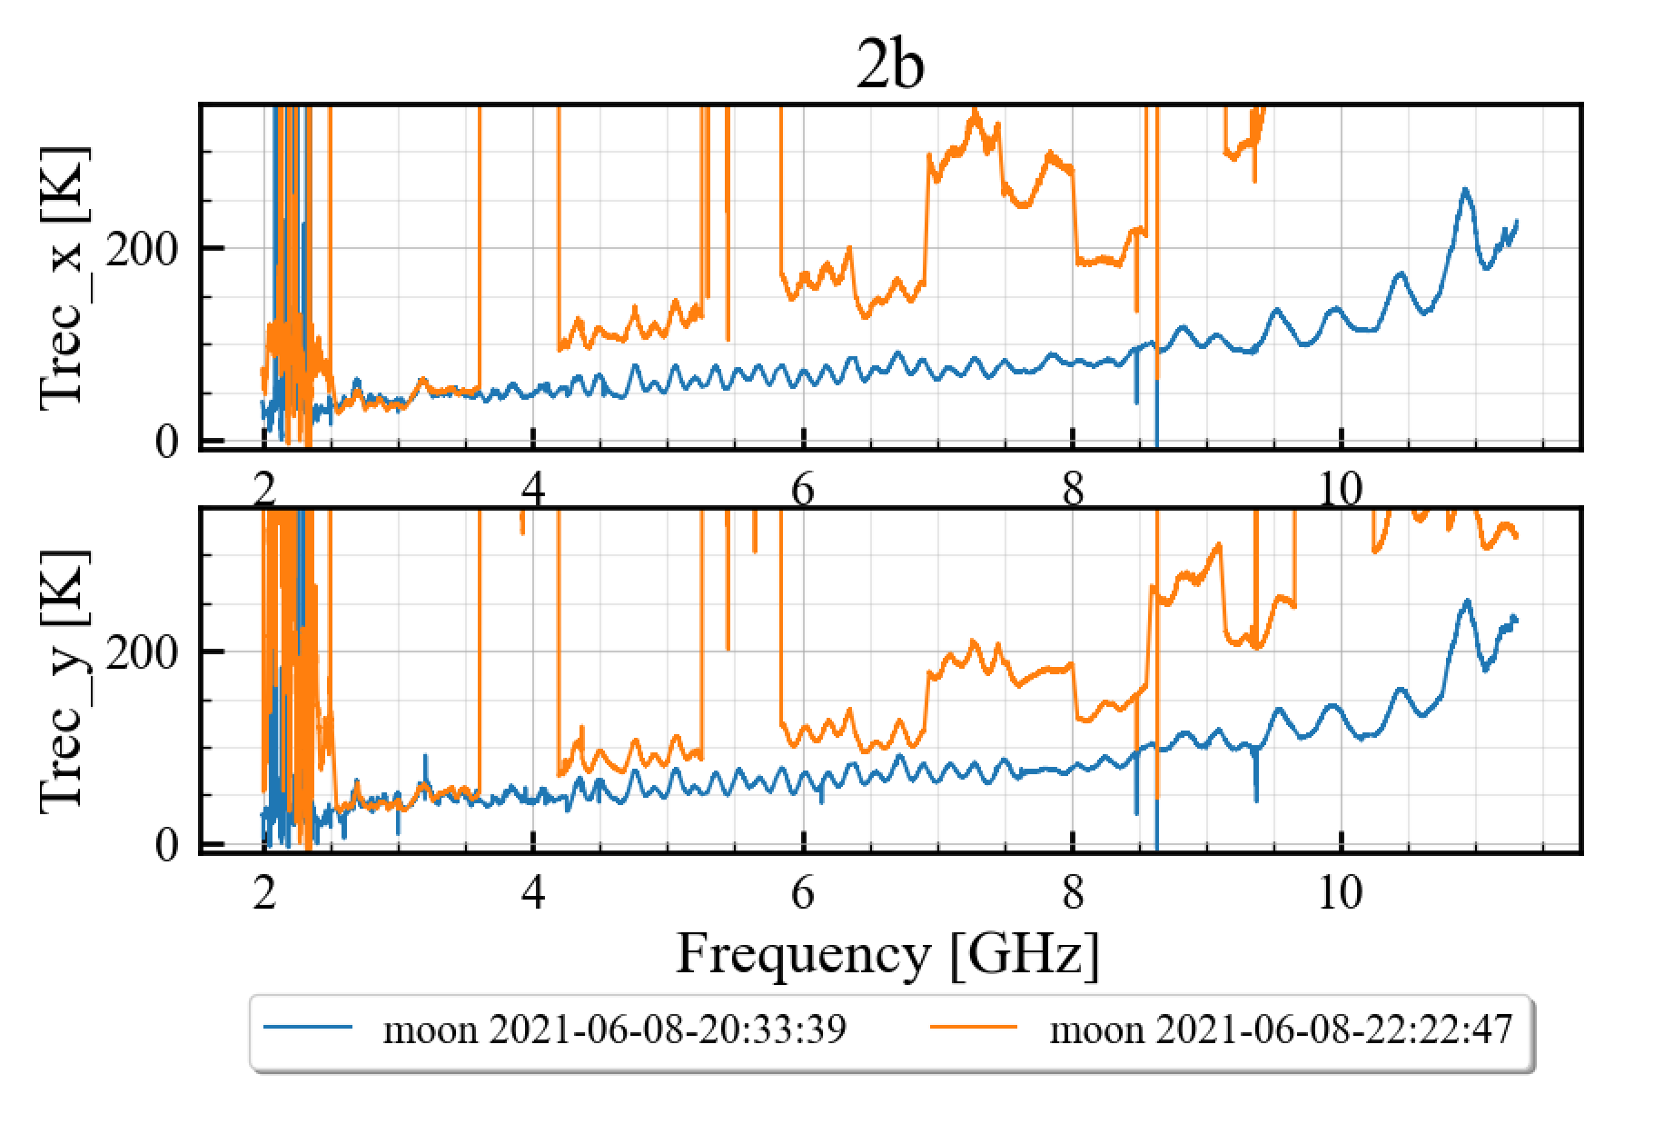
Sunbrella measurements:
SEFD with dry and wet sunbrella
Blue => dry sunbrella
Orange => wet sunbrella

Slide 9
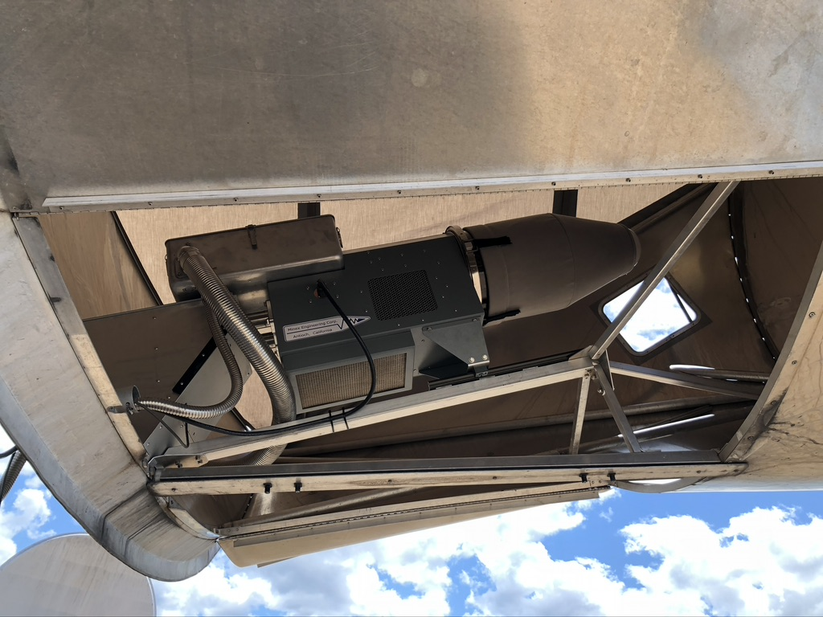
Feed focus measurements:
Fixed at 2GHz

Slide 10
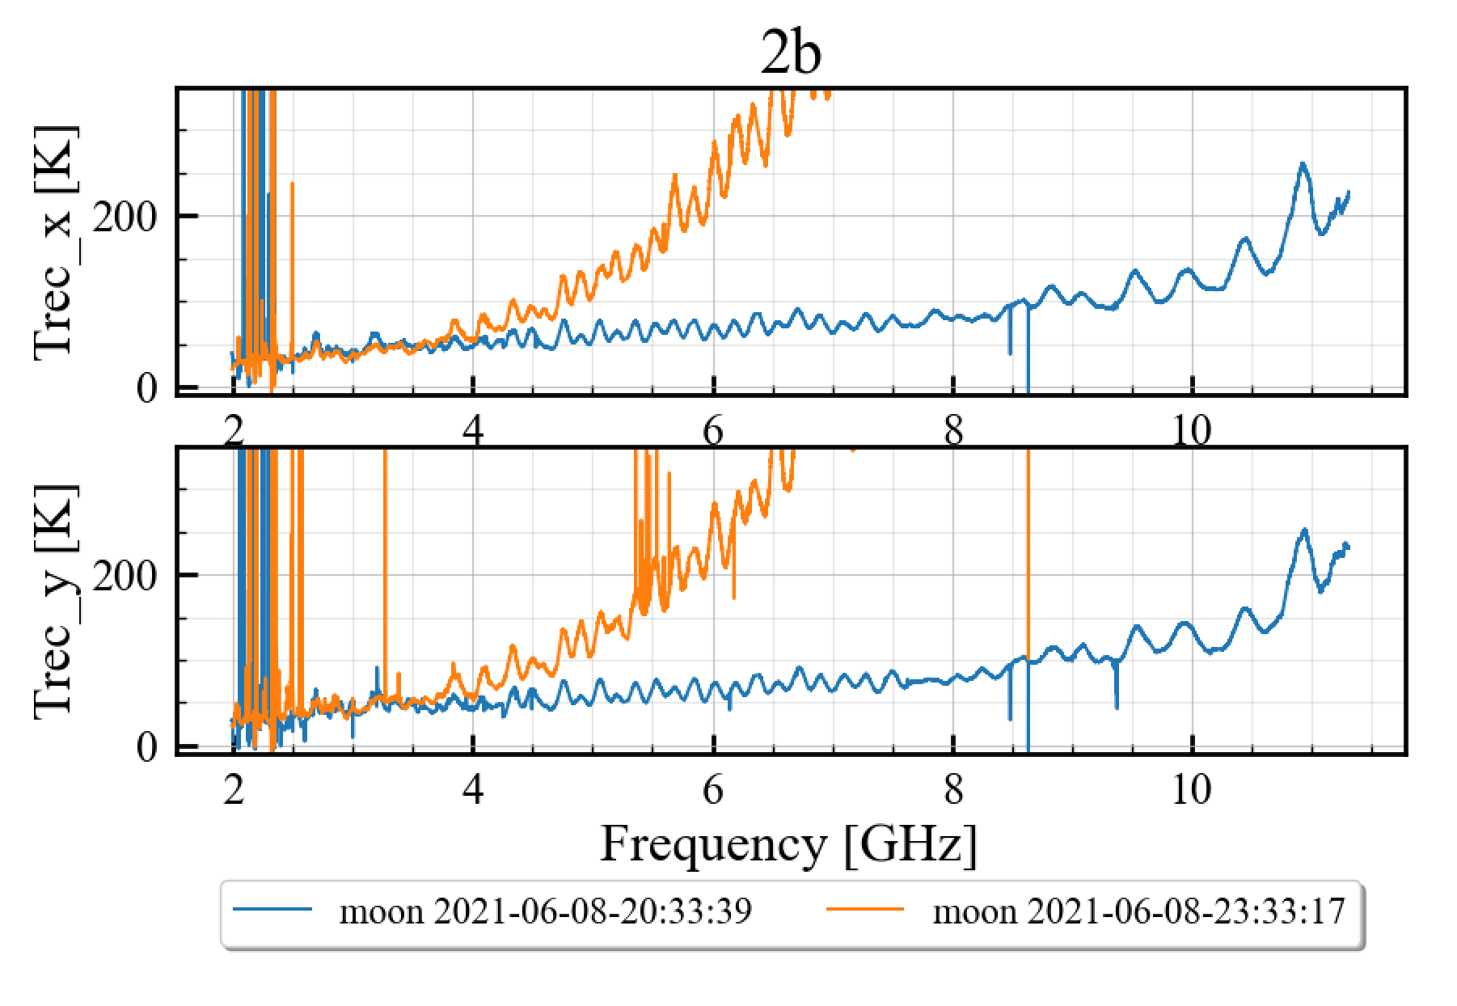
Feed focus measurements:
Fixed at 2GHz
Blue => with feed focused
Orange => fixed at 2GHz

Slide 11
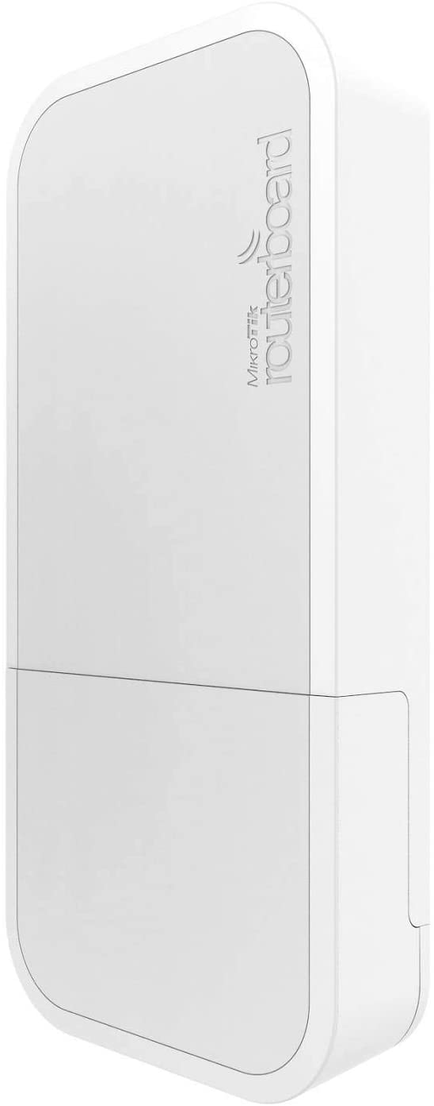
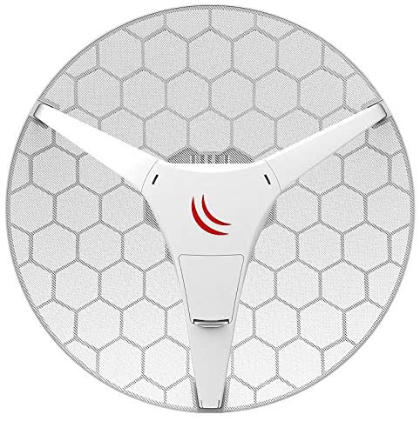
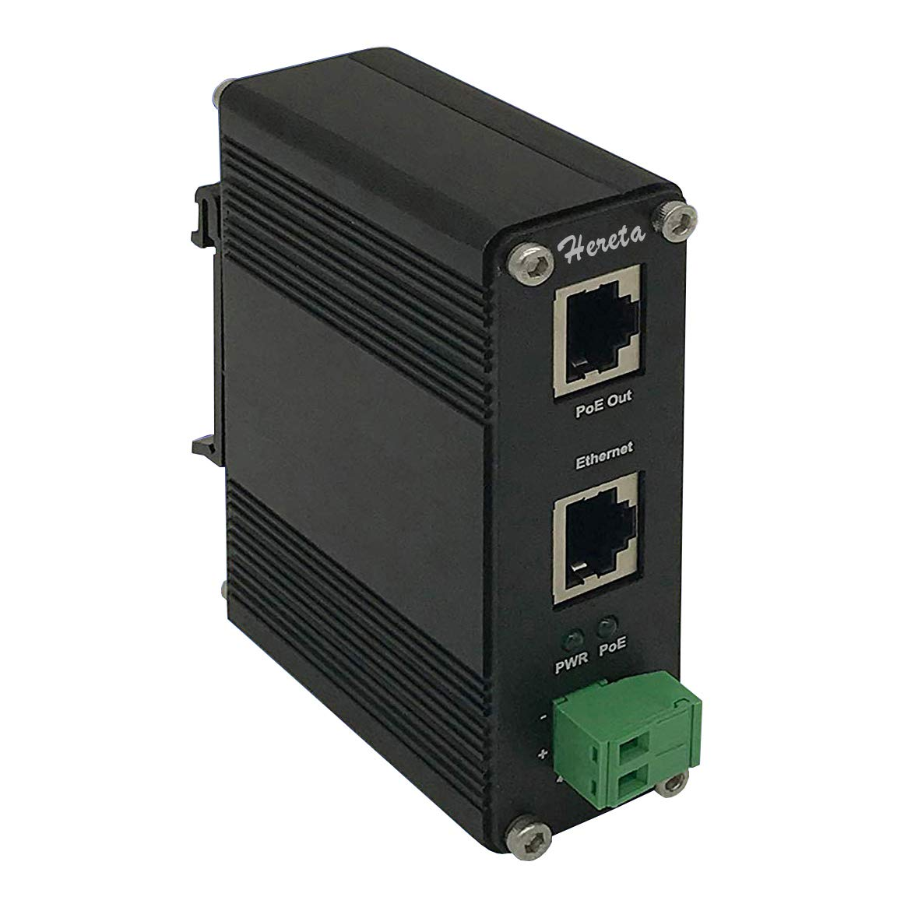
Feed focus measurement:
Mobile setup for maintenance
60GHz link for laptop
Total: $600

Slide 12
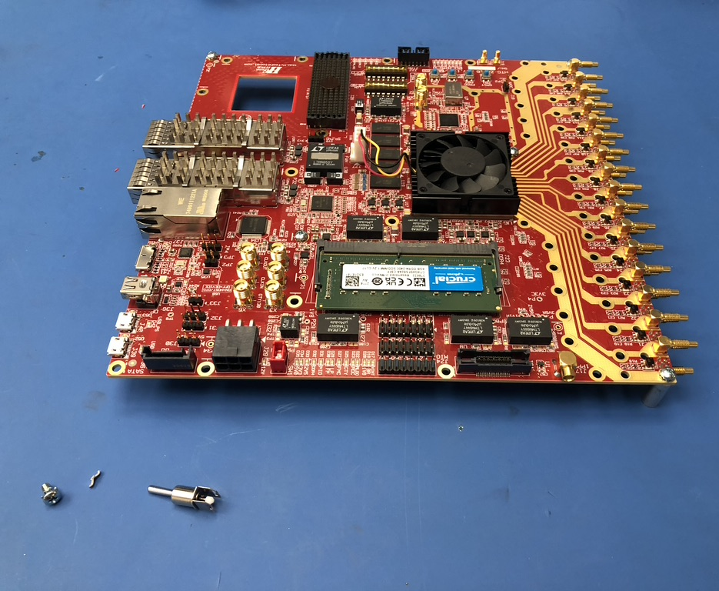
RFSoC DSP installation:

Slide 13
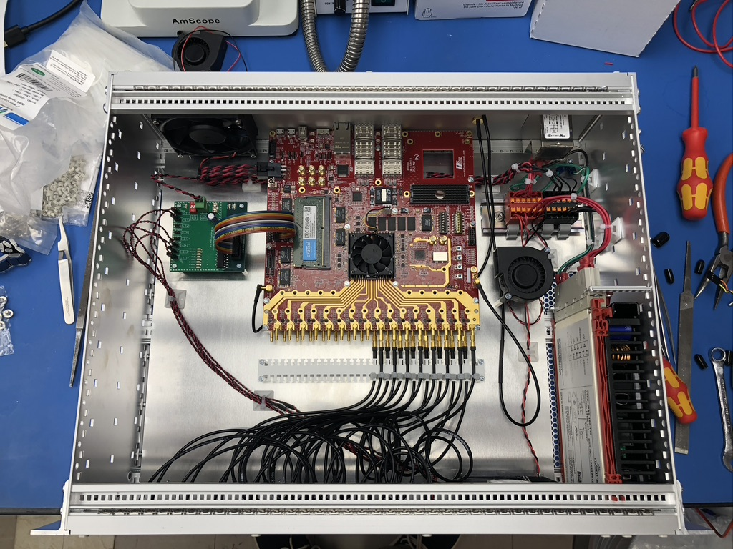
RFSoC DSP installation:

Slide 14
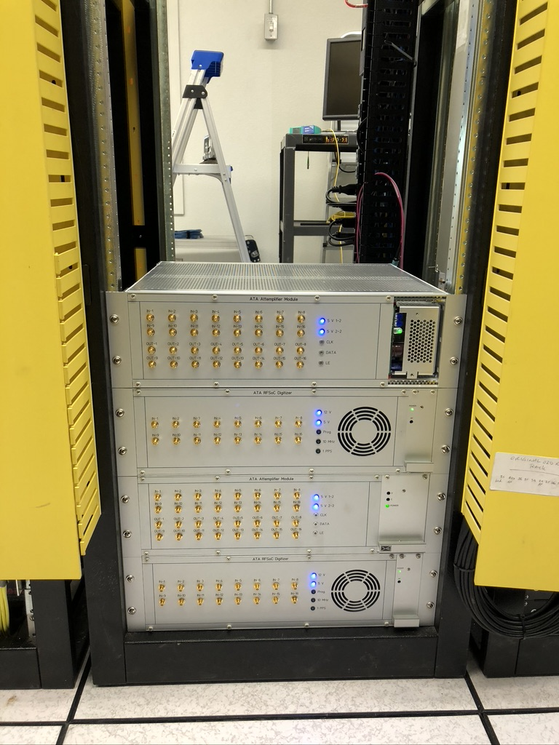
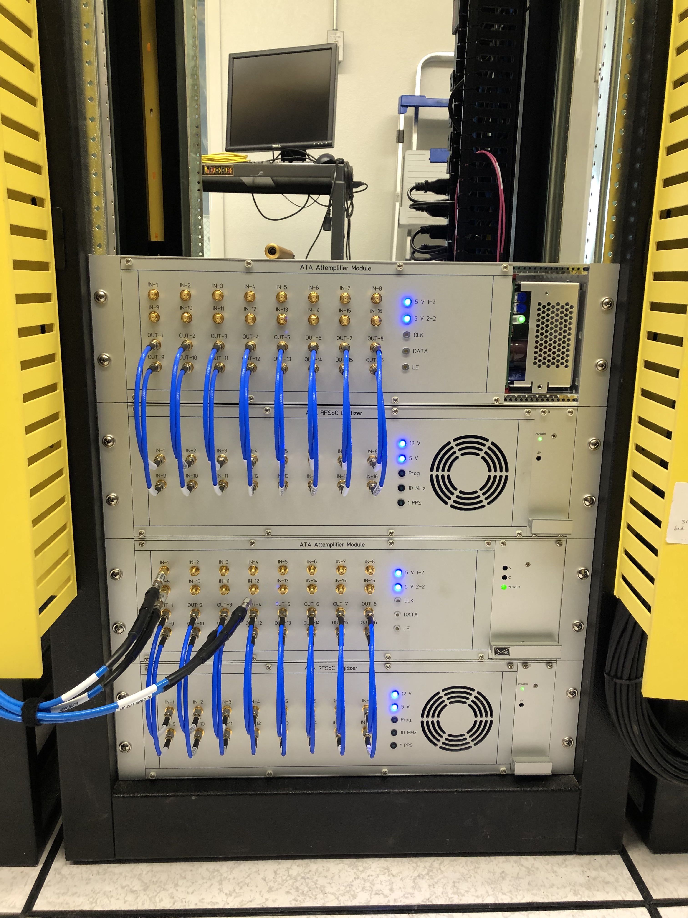
RFSoC DSP installation:

Slide 15
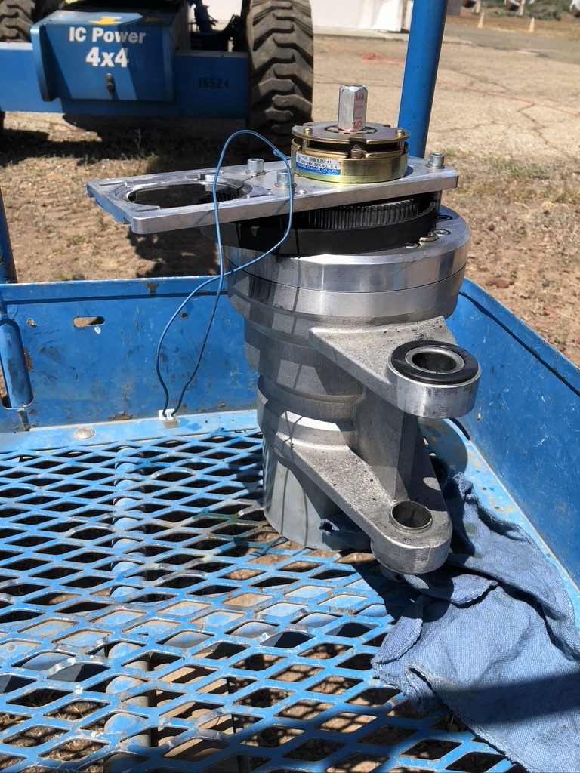
2B Azimuth gearbox:

Slide 16
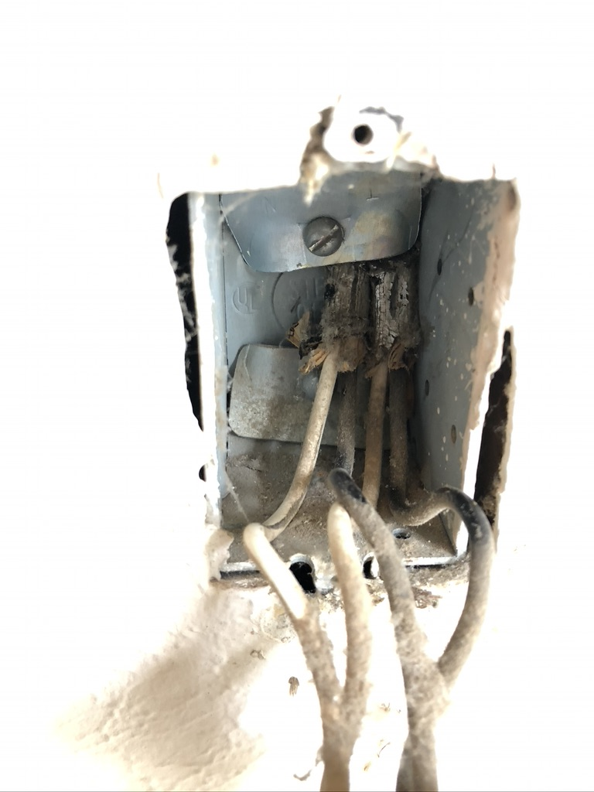
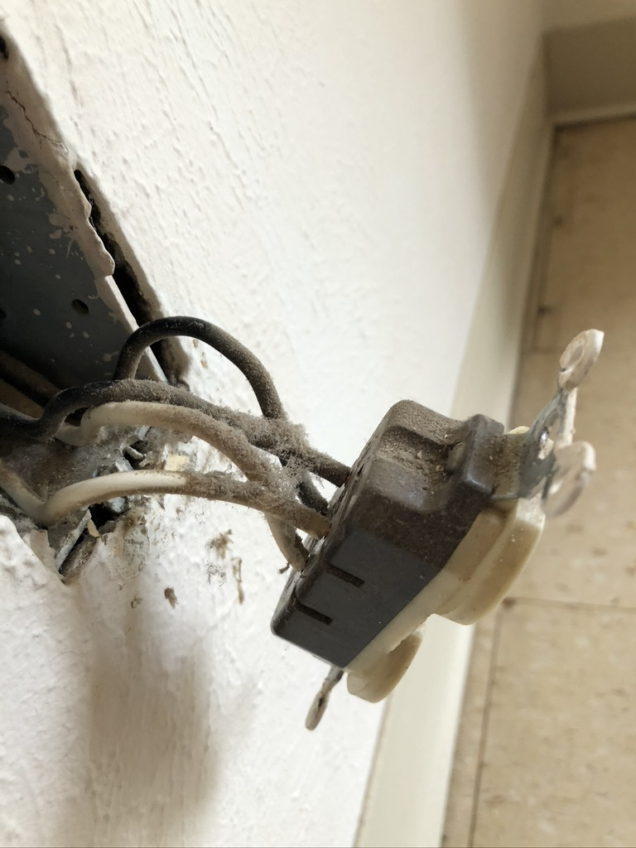
Berkeley House:
1st Electrician looked at the house

Slide 17
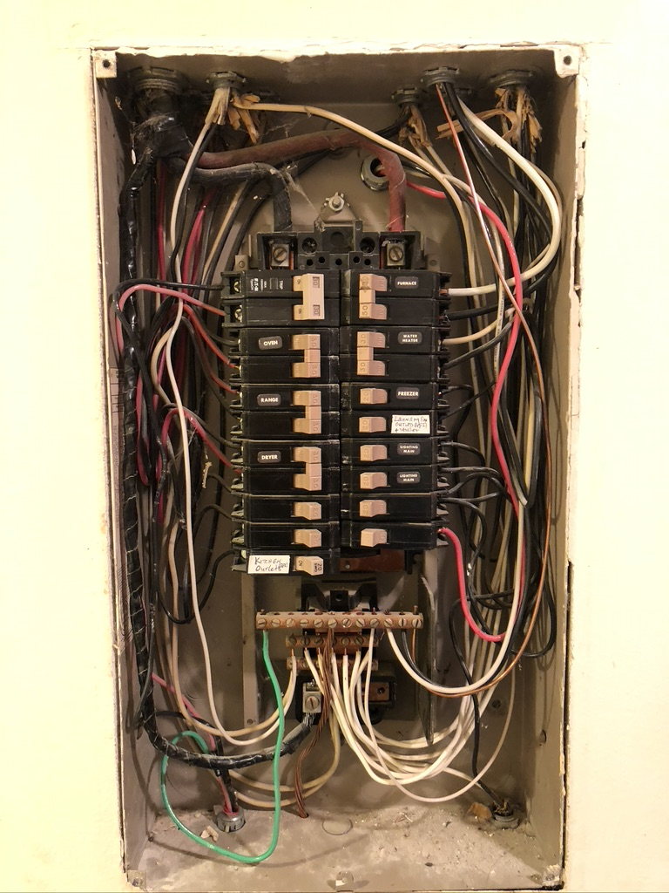
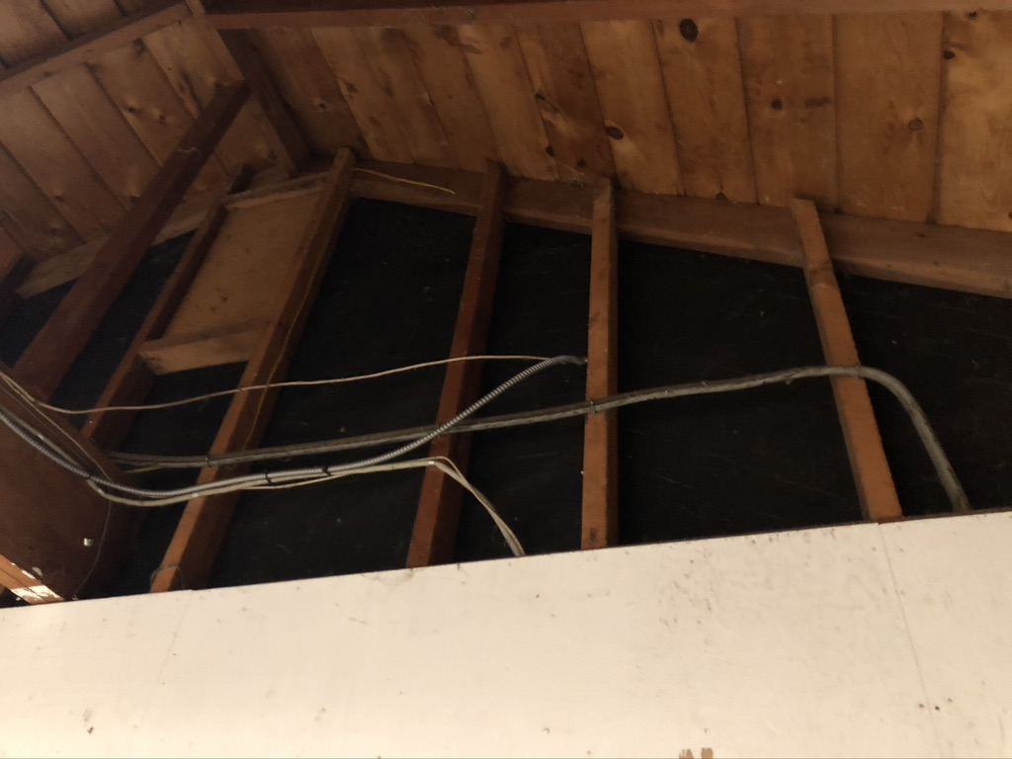
Berkeley House:
1st Electrician looked at the house

